Slide 1


Slide 2
The Cisco Service Oriented Network Architecture
Cisco vision and framework that enable customers to build a more intelligent network infrastructure.
The Cisco SONA architectural framework shifts the view of the network from a pure traffic transport-oriented view toward a service- and application-oriented view.

Slide 3
Business Drivers for a New Network Architecture
New business requirements, the growth of applications, and the evolution of IT combine to drive the need for a new network architecture.
In today’s business environment, intense competition and time-to-market pressures are prompting enterprises to look for new IT solutions that can help them better respond to market and customer demands.
Consumers are asking for new products and service offerings—and they want them fast. They are also demanding improved customer service, enhanced customization flexibility, and greater security, all at a lower cost.
Modern networks connect multiple resources and information assets within the organization as well as provide access to external resources.
In this environment, the IT model has evolved from mainframes, to client/server models, to Internet applications, as illustrated in Figure.
The Cisco vision of the next phase of IT evolution is a real-time infrastructure that integrates the network and the applications as one system.

Slide 4
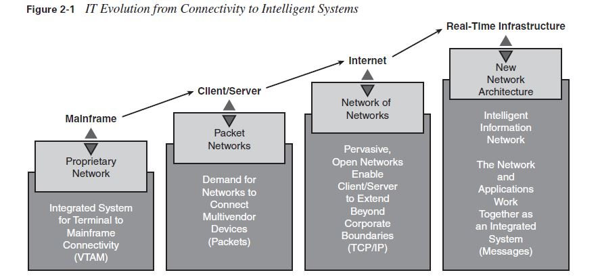

Slide 5
Organizations are finding that networking is no longer just about connectivity; rather, network intelligence is starting to play a role in improving business performance and processes.
Intelligence enhances the network’s role as a foundation for enabling communication,collaboration, and business success.
With increased awareness of the applications that operate on the network foundation, the network becomes an active participant in applications, network management, business systems, and services to enable them to work better.
The network is the common single element that connects and enables all components of the IT infrastructure.
Organizations need their networks to evolve to intelligent systems that participate actively in the delivery of applications to effectively reach the goals of improved productivity, reduced time to market, greater revenue, lower expenses, and stronger customer relationships.
An effective network provides the foundation for transforming business practices.

Slide 6
Intelligence in the Network
Integrating intelligence into the network involves aligning network and business requirements.
To accommodate today’s and tomorrow’s network requirements, the Cisco vision of the future includes the Intelligent Information Network (IIN), a strategy that addresses how the network is integrated with businesses and business priorities. This vision encompasses the following features:
Integration of networked resources and information assets that have been largely unlinked:
The modern converged networks with integrated voice, video, and data require that IT departments (and other departments traditionally responsible for other technologies) more closely link the IT infrastructure with the network.

Slide 7
Intelligence across multiple products and infrastructure layers:
The intelligence built in to each component of the network is extended network wide and applies end-to-end.
Active participation of the network in the delivery of services and applications:
With added intelligence, it is possible for the network to actively manage, monitor, and optimize service and application delivery across the entire IT environment.
KEY POINT
The intelligent network offers much more than basic connectivity, bandwidth for users, and access to applications. It offers end-to-end functionality and centralized, unified control that promotes true business transparency and agility

Slide 8
With this technology vision, Cisco is helping organizations address new IT challenges, such as the deployment of service-oriented architectures, web services, and virtualization (as described in the upcoming Phase 2 bullet).
This vision offers an evolutionary approach that consists of three phase in which functionality can be added to the infrastructure as required. The three phases are illustrated in Figure 2-2 and described as follows:
Phase 1: Integrated transport:
Everything (data, voice, and video) consolidates onto an IP network for secure network convergence. By integrating data, voice, and video transport into a single standards-based modular network, organizations can simplify network management and generate enterprise wide efficiencies. Network convergence also lays the foundation for a new class of IP-enabled applications, now known as Cisco Unified Communications solutions.

Slide 9
NOTE
Cisco Unified Communications is the name, launched in March 2006,, rich media clients, and voice application products. for the entire range of what were previously known as Cisco IP communications products. These include all call control, conferencing, voice mail and messaging, customer contact, IP phone, video telephony, videoconferencing

Slide 10
Phase 2: Integrated services: When the network infrastructure is converged, IT resources can be pooled and shared, or virtualized, to flexibly address the changing needs of the organization. By extending this virtualization concept to encompass server, storage, and network elements, an organization can transparently use all its resources more efficiently.
Business continuity is also enhanced because in the event of a local systems failure, shared resources across the intelligent network can provide needed services.
Phase 3: Integrated applications: This phase focuses on making the network application ware so that it can optimize application performance and more efficiently deliver networked applications to users. In addition to capabilities such as content caching, load balancing, and application-level security, application network services make it possible for the network to simplify the application infrastructure by integrating intelligent application message handling, optimization, and security into the existing network.

Slide 11
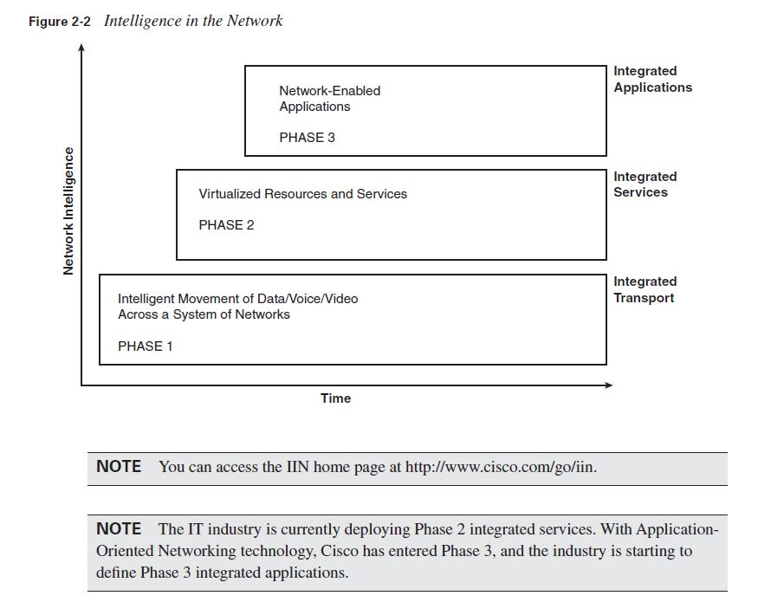

Slide 12
Cisco SONA Framework
The Cisco SONA is an architectural framework that illustrates how to build integrated systems and guides the evolution of enterprises toward more intelligent networks.
Using the SONA framework, enterprises can improve flexibility and increase efficiency by optimizing applications, business processes, and resources to enable IT to have a greater effect on business.
The SONA framework leverages the extensive product-line services, proven architectures, and experience of Cisco and its partners to help enterprises achieve their business goals.
The SONA framework, shown in Figure 2-3, shows how integrated systems can allow a dynamic, flexible architecture and provide for operational efficiency through standardization and virtualization.

Slide 13
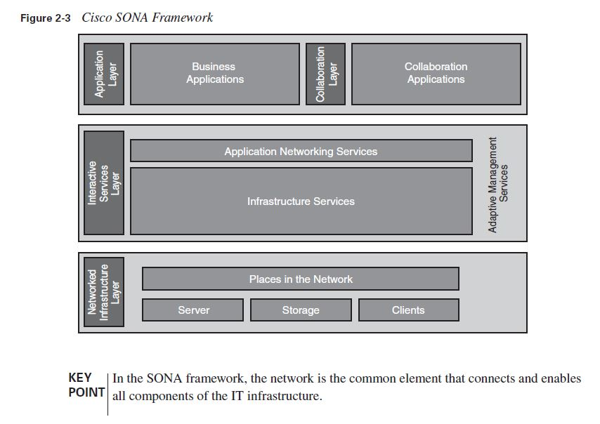

Slide 14
The SONA framework defines the following three layers:
Networked Infrastructure layer: Where all the IT resources are interconnected across a converged network foundation. The IT resources include servers, storage, and clients.
The Networked Infrastructure layer represents how these resources exist in different places in the network, including the campus, branch, data center, enterprise edge, WAN, metropolitan-area network (MAN), and with the teleworker.
The objective of this layer is to provide connectivity, anywhere and anytime.
The Networked Infrastructure layer includes the network devices and links to connect servers, storage, and clients in different places in the network.

Slide 15
Interactive Services layer: Includes both application networking services and infrastructure services. This layer enables efficient allocation of resources to applications and business processes delivered through the networked infrastructure. This layer includes the following services:
— Voice and collaboration services
— Mobility services
— Wireless services
— Security and identity services
— Storage services
— Compute services
— Application networking services (content networking services)
— Network infrastructure virtualization
— Adaptive network management services
— Quality of service (QoS)
— High availability
— IP multicast

Slide 16
Application layer: This layer includes business applications and collaboration applications.
The objective of this layer is to meet business requirements and achieve efficiencies by leveraging the interactive services layer. This layer includes the following collaborative applications:
— Instant messaging
— Cisco Unified Contact Center
— Cisco Unity (unified messaging)
— Cisco IP Communicator and Cisco Unified IP Phones
— Cisco Unified MeetingPlace
— Video delivery using Cisco Digital Media System
— IP telephony

Slide 17
NOTE
The preceding lists include voice as an infrastructure service and IP telephony as an application.
Note that some Cisco documentation uses the term IP telephony to describe the infrastructure service supported by other services, such as voice.
To avoid ambiguity, the term IP telephony is used in this book to describe the network application supported by other services, such as voice.

Slide 18
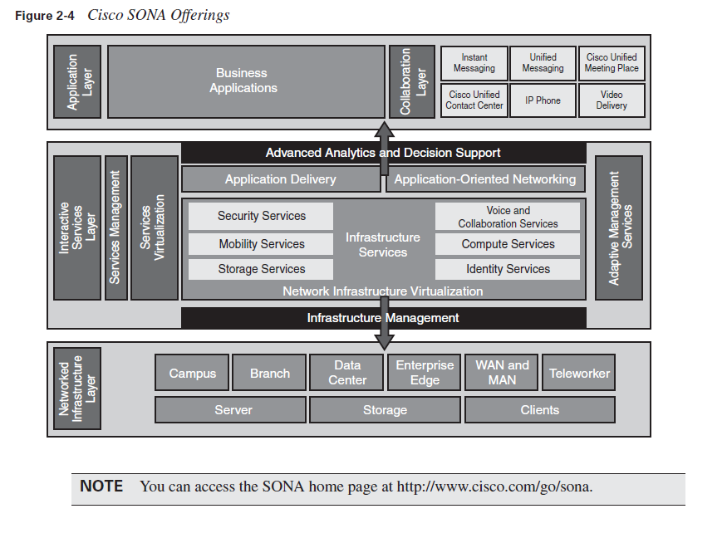

Slide 19
The benefits of SONA include the following:
Functionality: Supports the organizational requirements.
Scalability: Supports growth and expansion of organizational tasks by separating functions and products into layers; this separation makes it easier to grow the network.
Availability: Provides the necessary services, reliably, anywhere, anytime.
Performance: Provides the desired responsiveness, throughput, and utilization on a per application basis through the network infrastructure and services.
Manageability: Provides control, performance monitoring, and fault detection.
Efficiency: Provides the required network services and infrastructure with reasonable operational costs and appropriate capital investment on a migration path to a more intelligent network, through step-by-step network services growth.
Security: Provides for an effective balance between usability and security while protecting information assets and infrastructure from inside and outside threats.

Slide 20
Network Design Methodology
The network design methodology presented in this section is derived from the Cisco Prepare, Plan, Design, Implement, Operate, and Optimize (PPDIOO) methodology, which reflects a network’s lifecycle.
The following sections describe the PPDIOO phases and their relation to the network design methodology, and the benefits of the lifecycle approach to network design.

Slide 21
Design as an Integral Part of the PPDIOO Methodology
The PPDIOO network lifecycle, illustrated in Figure 2-5, reflects the phases of a standard network’s lifecycle. As shown in this figure, the PPDIOO lifecycle phases are separate, yet closely related.

Slide 22
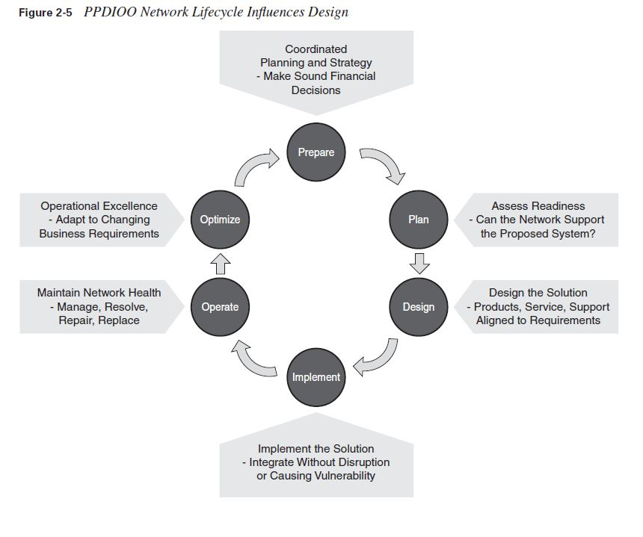

Slide 23
The following describes each PPDIOO phase:
Prepare phase:The Prepare phase involves establishing the organizational (business) requirements, developing a network strategy, and proposing a high-level conceptual architecture, identifying technologies that can best support the architecture.
Plan phase: This phase involves identifying the network requirements, which are based on the goals for the network, where the network will be installed, who will require which network services, and so forth.
Design phase: The initial requirements determined in the Plan phase drive the network design specialists’ activities. These specialists design the network according to those initial requirements, incorporating any additional data gathered during network analysis and network audit (when upgrading an existing network) and through discussion with managers and network users.
Implement phase: Implementation and verification begins after the design has been approved.

Slide 24
Operate phase: Operation is the final test of the design’s appropriateness. The Operate phase involves maintaining network health through day-to-day operations, which might include maintaining high availability and reducing expenses.
Optimize phase: The Optimize phase is based on proactive network management, the goal of which is to identify and resolve issues before real problems arise and the organization is affected.
Although Design is one of the six PPDIOO phases, all the other phases influence design decisions, and the Design phase interacts closely with them, as follows:
The requirements derived from the Prepare and Plan phases are the basis for network design.
The Implement phase includes the initial verification of the design on the actual network.
During the Operate and Optimize phases, the final decision is made about the appropriateness of the design, based on network analysis and any problems that arise.
The network might have to be redesigned to correct any discovered errors.

Slide 25
Benefits of the Lifecycle Approach to Network Design
The network lifecycle approach provides many benefits, including the following:
Lowering the total cost of network ownership:
— Identifying and validating technology requirements
— Planning for infrastructure changes and resource requirements
— Developing a sound network design aligned with technical requirements and business goals
— Accelerating successful implementation
— Improving the efficiency of the network and of the staff supporting it
— Reducing operating expenses by improving the efficiency of operation processes and tools

Slide 26
Increasing network availability:
— Assessing the state of the network’s security and its ability to support the proposed design
— Specifying the correct set of hardware and software releases and keeping them operational and current
— Producing a sound operational design and validating network operation
— Staging and testing the proposed system before deployment
— Improving staff skills
— Proactively monitoring the system and assessing availability trends and alerts
— Proactively identifying security breaches and defining remediation plans

Slide 27
Improving business agility:
— Establishing business requirements and technology strategies
— Readying sites to support the system to be implemented
— Integrating technical requirements and business goals into a detailed design and demonstrating that the network is functioning as specified
— Expertly installing, configuring, and integrating system components
— Continually enhancing performance
Accelerating access to applications and services:
— Assessing and improving operational preparedness to support current and planned network technologies and services
— Improving service-delivery efficiency and effectiveness by increasing availability, resource capacity, and performance
— Improving the availability, reliability, and stability of the network and the applications running on it
— Managing and resolving problems affecting the system and keeping software applications current

Slide 28
Design Methodology
When working in an environment that requires creative production on a tight schedule—for example, when designing an internetwork—using a methodology can be helpful. A methodology is a documented, systematic way of doing something.
Following a design methodology can have many advantages:
It ensures that no step is missed when the process is followed.
It provides a framework for the design process deliverables.
It encourages consistency in the creative process, enabling network designers to set appropriate deadlines and maintain customer and manager satisfaction.
It allows customers and managers to validate that the designers have thought about how to meet their requirements.

Slide 29
Using the Top-Down Approach to Network Design
The Top-Down Approach to Network Design
Designing a large or even medium-sized network can be a complex project.
Procedures have been developed to facilitate the design process by dividing it into smaller, more manageable steps.
Identifying the separate steps or tasks ensures a smooth process and reduces potential risks.
A top-down design allows the designer to “see the big picture” before getting to the details.
Topdown design clarifies the design goals and initiates the design from the perspective of the required applications.
The top-down approach adapts the physical infrastructure to the needs of the applications.
Network devices are chosen only after a thorough requirements analysis. Structured design practices should be integrated with the top-down approach, especially in very complex networks.
In contrast to top-down design, the network design approach in which network devices and technologies are selected first is called bottom-up, or connect-the-dots.
This approach often results in an inappropriate network for the required services and is primarily used when a very quick response to the design request is needed. With a bottom-up approach, the risk of having to redesign the network is high.

Slide 30
Guidelines for producing a top-down design include the following:
Thoroughly analyze the customer’s requirements.
Initiate the design from the top of the OSI model. In other words, define the upper OSI layers (application, presentation, and session) first, and then define the lower OSI layers (transport, network, data link, and physical)—the infrastructure (routers, switches, and media) that is required.
Gather additional data about the network (protocol behavior, scalability requirements, additional requirements from the customer, and so forth) that might influence the logical and physical design. Adapt the design to the new data, as required.

Slide 31
Top-Down Approach Compared to Bottom-Up Approach
A top-down approach to design has many benefits compared to a bottom-up approach, including the following:
Incorporating the customer organization’s requirements
Providing the customer and the designer with the “big picture” of the desired network
Providing a design that is appropriate for both current requirements and future development
The disadvantage of the top-down approach is that it is more time-consuming than the bottom-up approach; it necessitates a requirement analysis so that the design can be adapted to the identified needs.
A benefit of the bottom-up approach—selecting the devices and technologies and then moving toward services and applications—is that it allows a quick response to a design request.
This design approach facilitates designs based on the designer’s previous experience.
The major disadvantage of the bottom-up approach is that it can result in an inappropriate design, leading to costly redesign.

Slide 32
Network Hierarchy
This section explains the hierarchical network model, which is composed of the access, distribution, and core layers.
The functions generally associated with each of these layers are discussed, as is the most common approach to designing a hierarchical network.
Historically used in the design of enterprise local-area network and wide-area network data networks, this model works equally well within the functional modules of the Cisco Enterprise Architecture.
These modules are discussed later in this chapter, in the section “Using a Modular Approach to Network Design.”
Hierarchical Network Model
The hierarchical network model provides a framework that network designers can use to help ensure that the network is flexible and easy to implement and troubleshoot.

Slide 33
Hierarchical Network Design Layers
As shown in Figure 3-1, the hierarchical network design model consists of three layers:
The access layer provides local and remote workgroup or user access to the network.
The distribution layer provides policy-based connectivity.
The core (or backbone) layer provides high-speed transport to satisfy the connectivity and transport needs of the distribution layer devices.

Slide 34
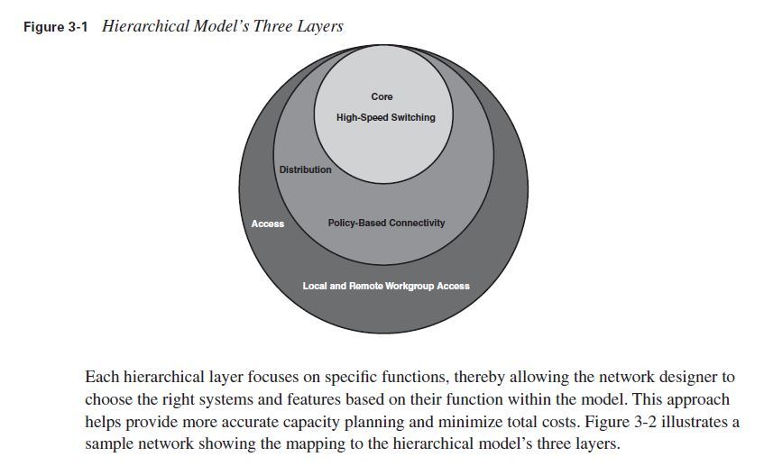

Slide 35
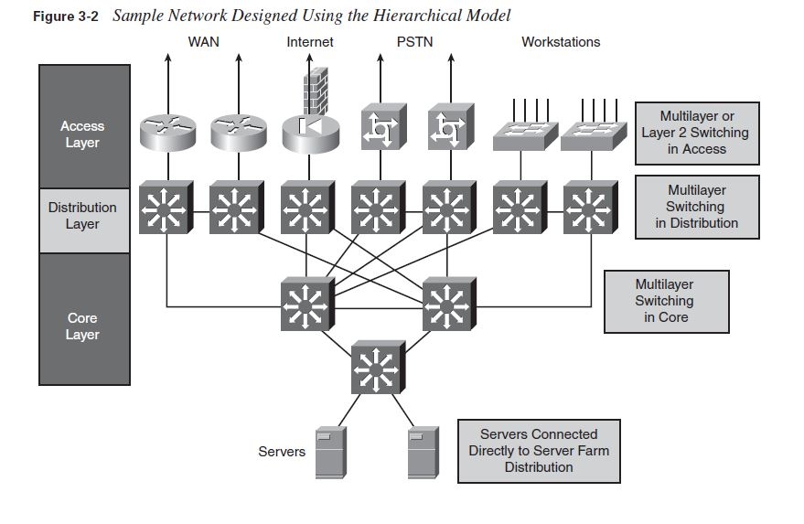

Slide 36
Access Layer Functionality
The Role of the Access Layer
The access layer is the concentration point at which clients access the network.
Access layer devices control traffic by localizing service requests to the access media.
The purpose of the access layer is to grant user access to network resources. Following are the
access layer’s characteristics:
■ In the campus environment, the access layer typically incorporates switched LAN devices with ports that provide connectivity for workstations and servers.
■ In the WAN environment, the access layer for teleworkers or remote sites provides access to the corporate network across some wide-area technology, such as Frame Relay, Multiprotocol Label Switching (MPLS), Integrated Services Digital Network, leased lines, Digital Subscriber Line (DSL) over traditional telephone copper lines, or coaxial cable.
■ So as not to compromise network integrity, access is granted only to authenticated users or devices (such as those with physical address or logical name authentication). For example, the devices at the access layer must detect whether a telecommuter who is dialing in is legitimate, yet they must require minimal authentication steps for the telecommuter.

Slide 37
Distribution Layer Functionality
The Role of the Distribution Layer
The distribution layer represents both a separation between the access and core layers and a connection point between the diverse access sites and the core layer.
The distribution layer determines department or workgroup access and provides policy-based connectivity.
Following are the characteristics of the distribution layer:
■ Distribution layer devices control access to resources that are available at the core layer and must therefore use bandwidth efficiently
■ In a campus environment, the distribution layer aggregates wiring closet bandwidth by concentrating multiple low-speed access links into a high-speed core link and using switches to segment workgroups and isolate network problems to prevent them from affecting the core layer.
■ Similarly, in a WAN environment, the distribution layer aggregates WAN connections at the edge of the campus and provides policy-based connectivity.

Slide 38
This layer provides redundant connections for access devices. Redundant connections also provide the opportunity to load-balance between devices.
■ The distribution layer represents a routing boundary between the access and core layers and is where routing and packet manipulation are performed.
■ The distribution layer allows the core layer to connect diverse sites while maintaining high performance. To maintain good performance in the core, the distribution layer can redistribute between bandwidth-intensive access-layer routing protocols and optimized core routing protocols. Route filtering is also implemented at the distribution layer.
■ The distribution layer can summarize routes from the access layer to improve routing protocol performance. For some networks, the distribution layer offers a default route to access-layer routers and runs dynamic routing protocols only when communicating with core routers.
■ The distribution layer connects network services to the access layer and implements policies for QoS, security, traffic loading, and routing. For example, the distribution layer addresses different protocols’ QoS needs by implementing policy-based traffic control to isolate backbone and local environments. Policy-based traffic control prioritizes traffic to ensure the best performance for the most time-critical and time-dependent applications.
■ The distribution layer is often the layer that terminates access layer VLANs (broadcast domains); however, this can also be done at the access layer.
■ This layer provides any media transitions (for example, between Ethernet and ATM) that must occur.

Slide 39
Core Layer Functionality
The Role of the Core Layer
The function of the core layer is to provide fast and efficient data transport. Characteristics of the core layer include the following:
■ The core layer is a high-speed backbone that should be designed to switch packets as quickly as possible to optimize communication transport within the network.
■ Because the core is critical for connectivity, core layer devices are expected to provide a high level of availability and reliability. A fault-tolerant network design ensures that failures do not have a major impact on network connectivity. The core must be able to accommodate failures by rerouting traffic and responding quickly to changes in network topology.
The core must provide a high level of redundancy. A full mesh is strongly suggested, and at least a well connected partial mesh with multiple paths from each device is required.
■ The core layer should not perform any packet manipulation, such as checking access lists or filtering, which would slow down the switching of packets.
■ The core layer must be manageable.
■ The core devices must be able to implement scalable protocols and technologies, and providealternative paths and load balancing.

Slide 40
Designing a Campus Network Design Topology. Campus Design Considerations
The multilayer approach to campus network design combines data link layer and multilayer switching to achieve robust, highly available campus networks.
This section discusses factors to consider in a Campus LAN design.

Slide 41
Designing an Enterprise Campus
The Enterprise Campus network is the foundation for enabling business applications, enhancing productivity, and providing a multitude of services to end users. The following three characteristics should be considered when designing the campus network:

Slide 42
Network application characteristics: The organizational requirements, services, and applications place stringent requirements on a campus network solution—for example, in terms of bandwidth and delay.
■ Environmental characteristics: The network’s environment includes its geography and the transmission media used.
— The physical environment of the building or buildings influences the design, as do the number of, distribution of, and distance between the network nodes (including end users, hosts, and network devices). Other factors include space, power, and heating, ventilation, and air conditioning support for the network devices.
— Cabling is one of the biggest long-term investments in network deployment. Therefore, transmission media selection depends not only on the required bandwidth and distances, but also on the emerging technologies that might be deployed over the same infrastructure in the future.

Slide 43
Infrastructure device characteristics: The characteristics of the network devices selected influence the design (for example, they determine the network’s flexibility) and contribute to the overall delay. Trade-offs between data link layer switching
—based on media access control (MAC) addresses—and multilayer switching—based on network layer addresses, transport layer, and application awareness—need to be considered.
— High availability and high throughput are requirements that might require consideration throughout the infrastructure.
— Most Enterprise Campus designs use a combination of data link layer switching in the access layer and multilayer switching in the distribution and core layers.

Slide 44
Network Application Characteristics and Considerations
The network application’s characteristics and requirements influence the design in many ways.
The applications that are critical to the organization, and the network demands of these applications, determine enterprise traffic patterns inside the Enterprise Campus network, which influences bandwidth usage, response times, and the selection of the transmission medium.
Different types of application communication result in varying network demands. The following sections review four types of application communication:
■ Peer-peer
■ Client–local server
■ Client–Server Farm
■ Client–Enterprise Edge server

Slide 45
Peer-Peer Applications
From the network designer’s perspective, peer-peer applications include applications in which the majority of network traffic passes from one network edge device to another through the organization’s network, as shown in Figure . Typical peer-peer applications include the following:
Instant messaging: After the connection is established, the conversation is directly between two peers.

Slide 46
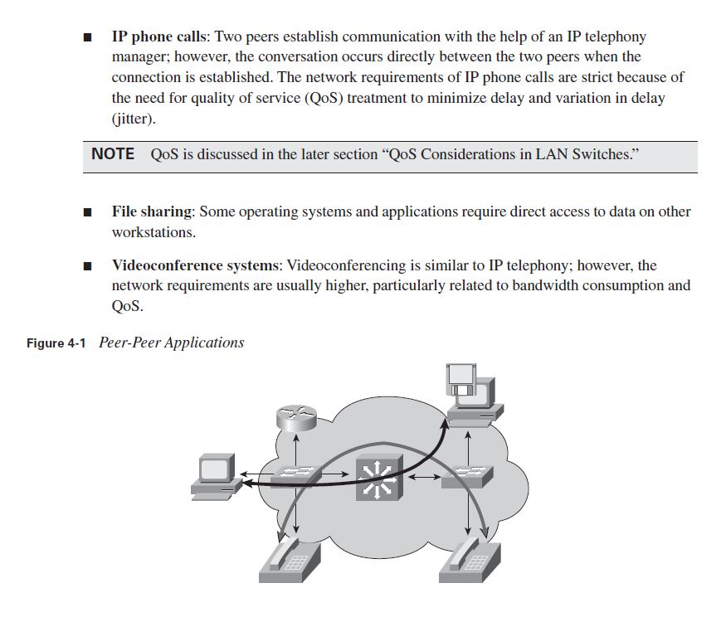

Slide 47
Client–Local Server Applications
Historically, clients and servers were attached to a network device on the same LAN segment and followed the 80/20 workgroup rule for client/server applications. This rule indicates that 80 percent of the traffic is local to the LAN segment and 20 percent leaves the segment.
With increased traffic on the corporate network and a relatively fixed location for users, an organization might split the network into several isolated segments, as shown in Figure . Each of these segments has its own servers, known as local servers, for its application.
In this scenario, servers and users are located in the same VLAN, and department administrators manage and control the servers.
The majority of department traffic occurs in the same segment, but some data exchange (to a different VLAN) happens over the campus backbone.

Slide 48
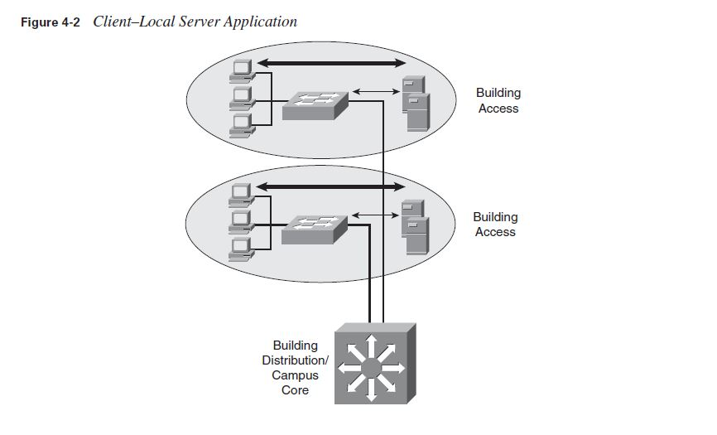
The bandwidth requirements for traffic passing to another segment typically are not crucial. For example, traffic to the Internet goes through a common segment and has lower performance requirements than traffic to the local segment servers.

Slide 49
Client–Server Farm Applications
Large organizations require their users to have fast, reliable, and controlled access to critical applications.
Because high-performance multilayer switches have an insignificant switch delay, and because of the reduced cost of network bandwidth, locating the servers centrally rather than in the workgroup is technically feasible and reduces support costs.
To fulfill these demands and keep administrative costs down, the servers are located in a common Server Farm, as shown in Figure 4-3. Using a Server Farm requires a network infrastructure that is highly resilient (providing security) and redundant (providing high availability) and that provides adequate throughput. High-end LAN switches with the fastest LAN technologies, such as Gigabit Ethernet, are typically deployed in such an environment.

Slide 50
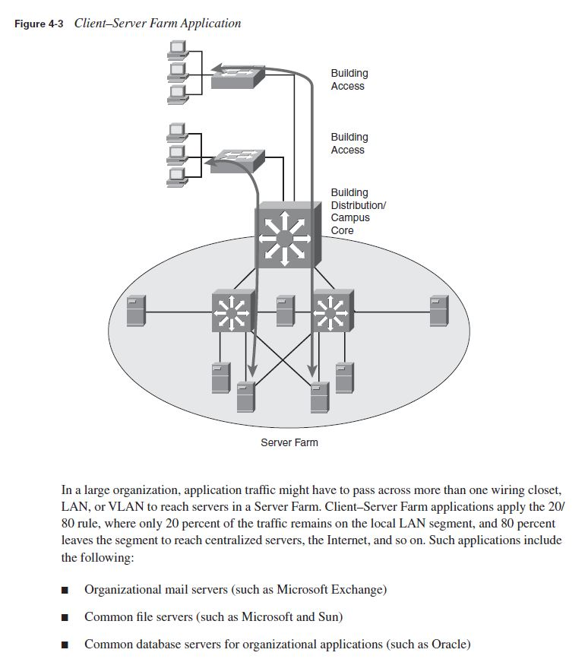

Slide 51
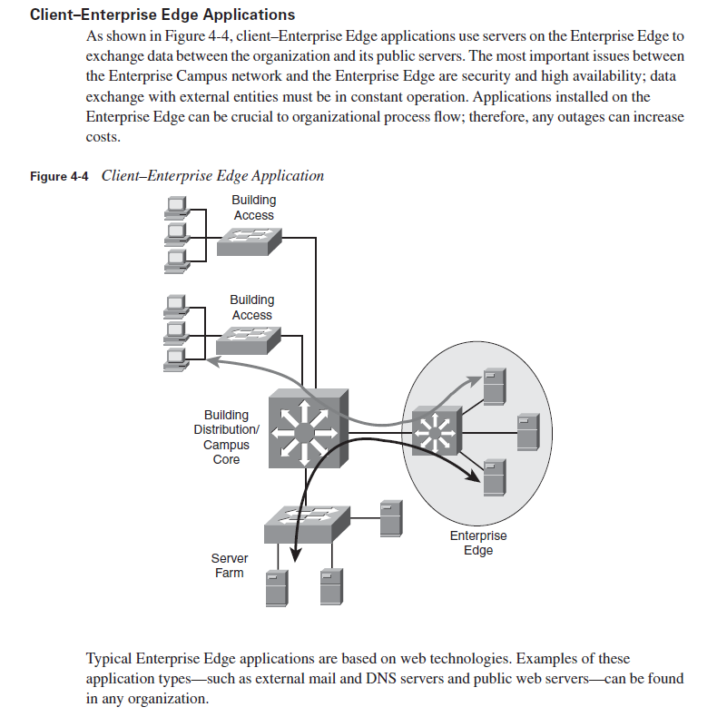
Client–Enterprise Edge Applications

